Slide 2
Question
1
When is Remembrance Day?

Slide 3
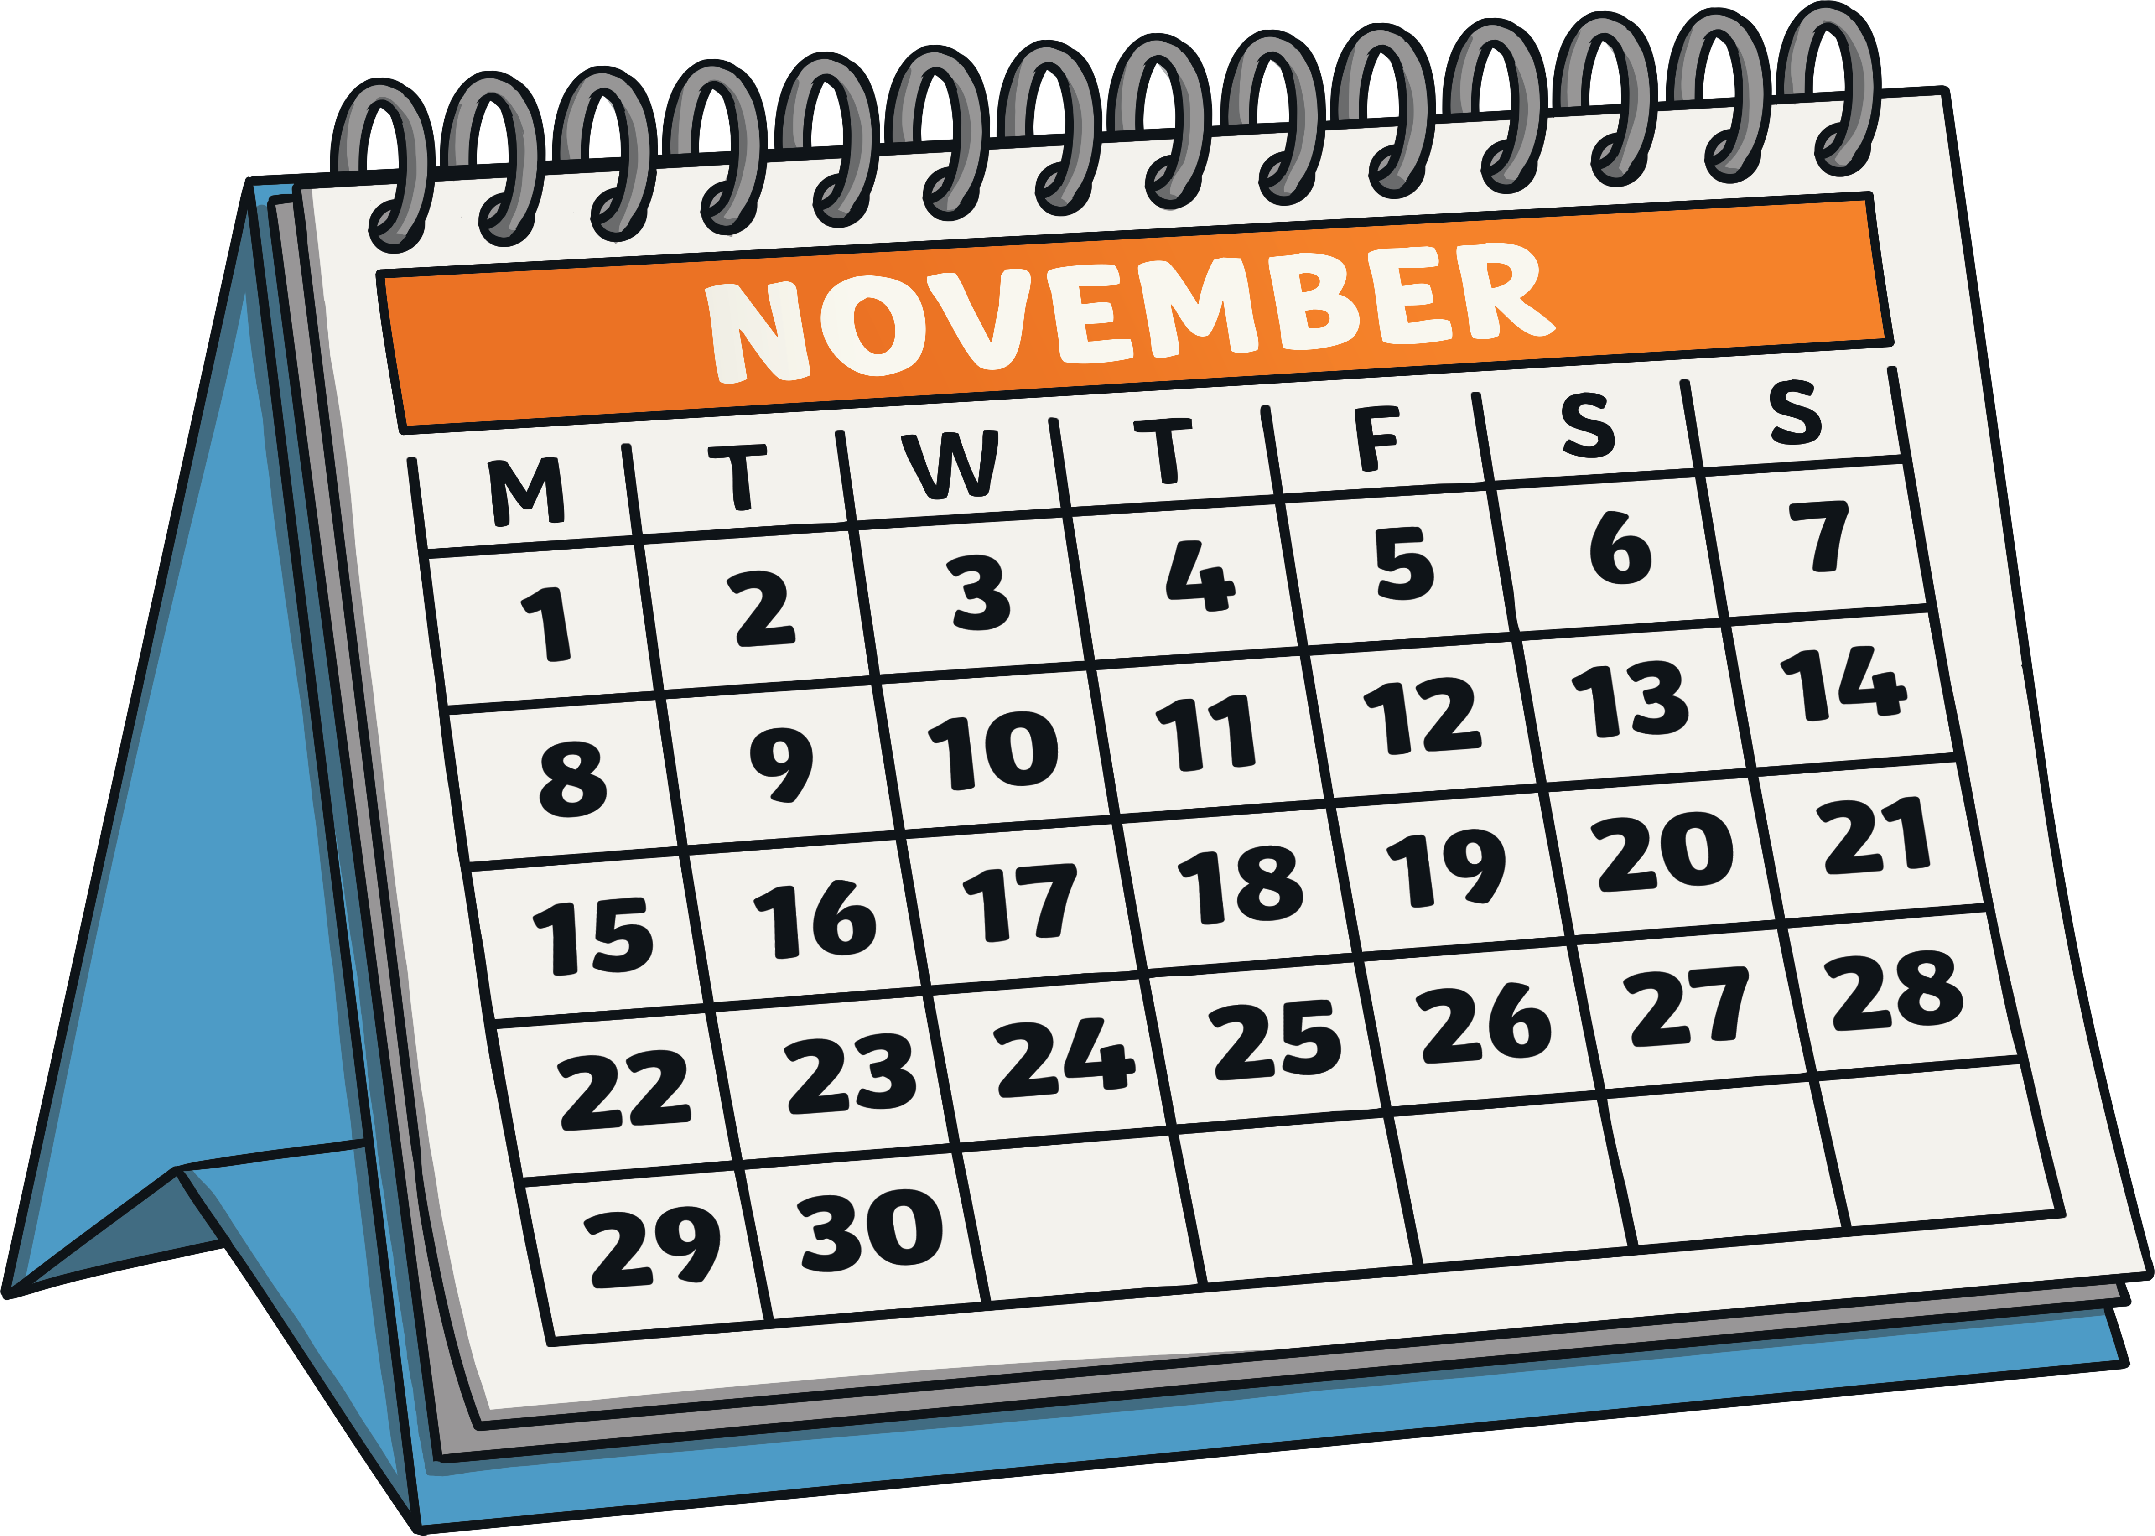
Answer
1
Remembrance Day is observed every year on November 11th. We have a moment of silence at 11 a.m., to remember all of the people who have sacrificed for us to have peace and freedom in our beautiful country.

Slide 4
Question
2
What is Remembrance Day?

Slide 5
Answer
2
On Remembrance Day, we think about all of the soldiers who have fought in wars to keep us safe.

Slide 6
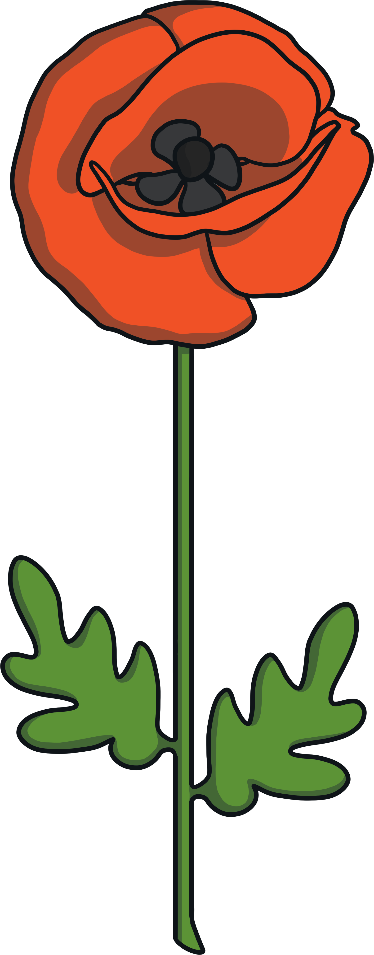
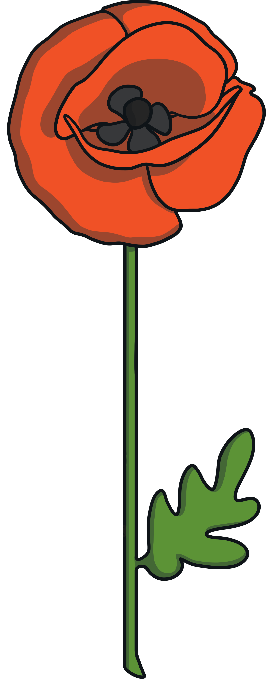
Question
3
What is the name of the flower we wear on Remembrance Day?

Slide 7
Answer
3
We wear poppies on Remembrance Day.

Slide 8
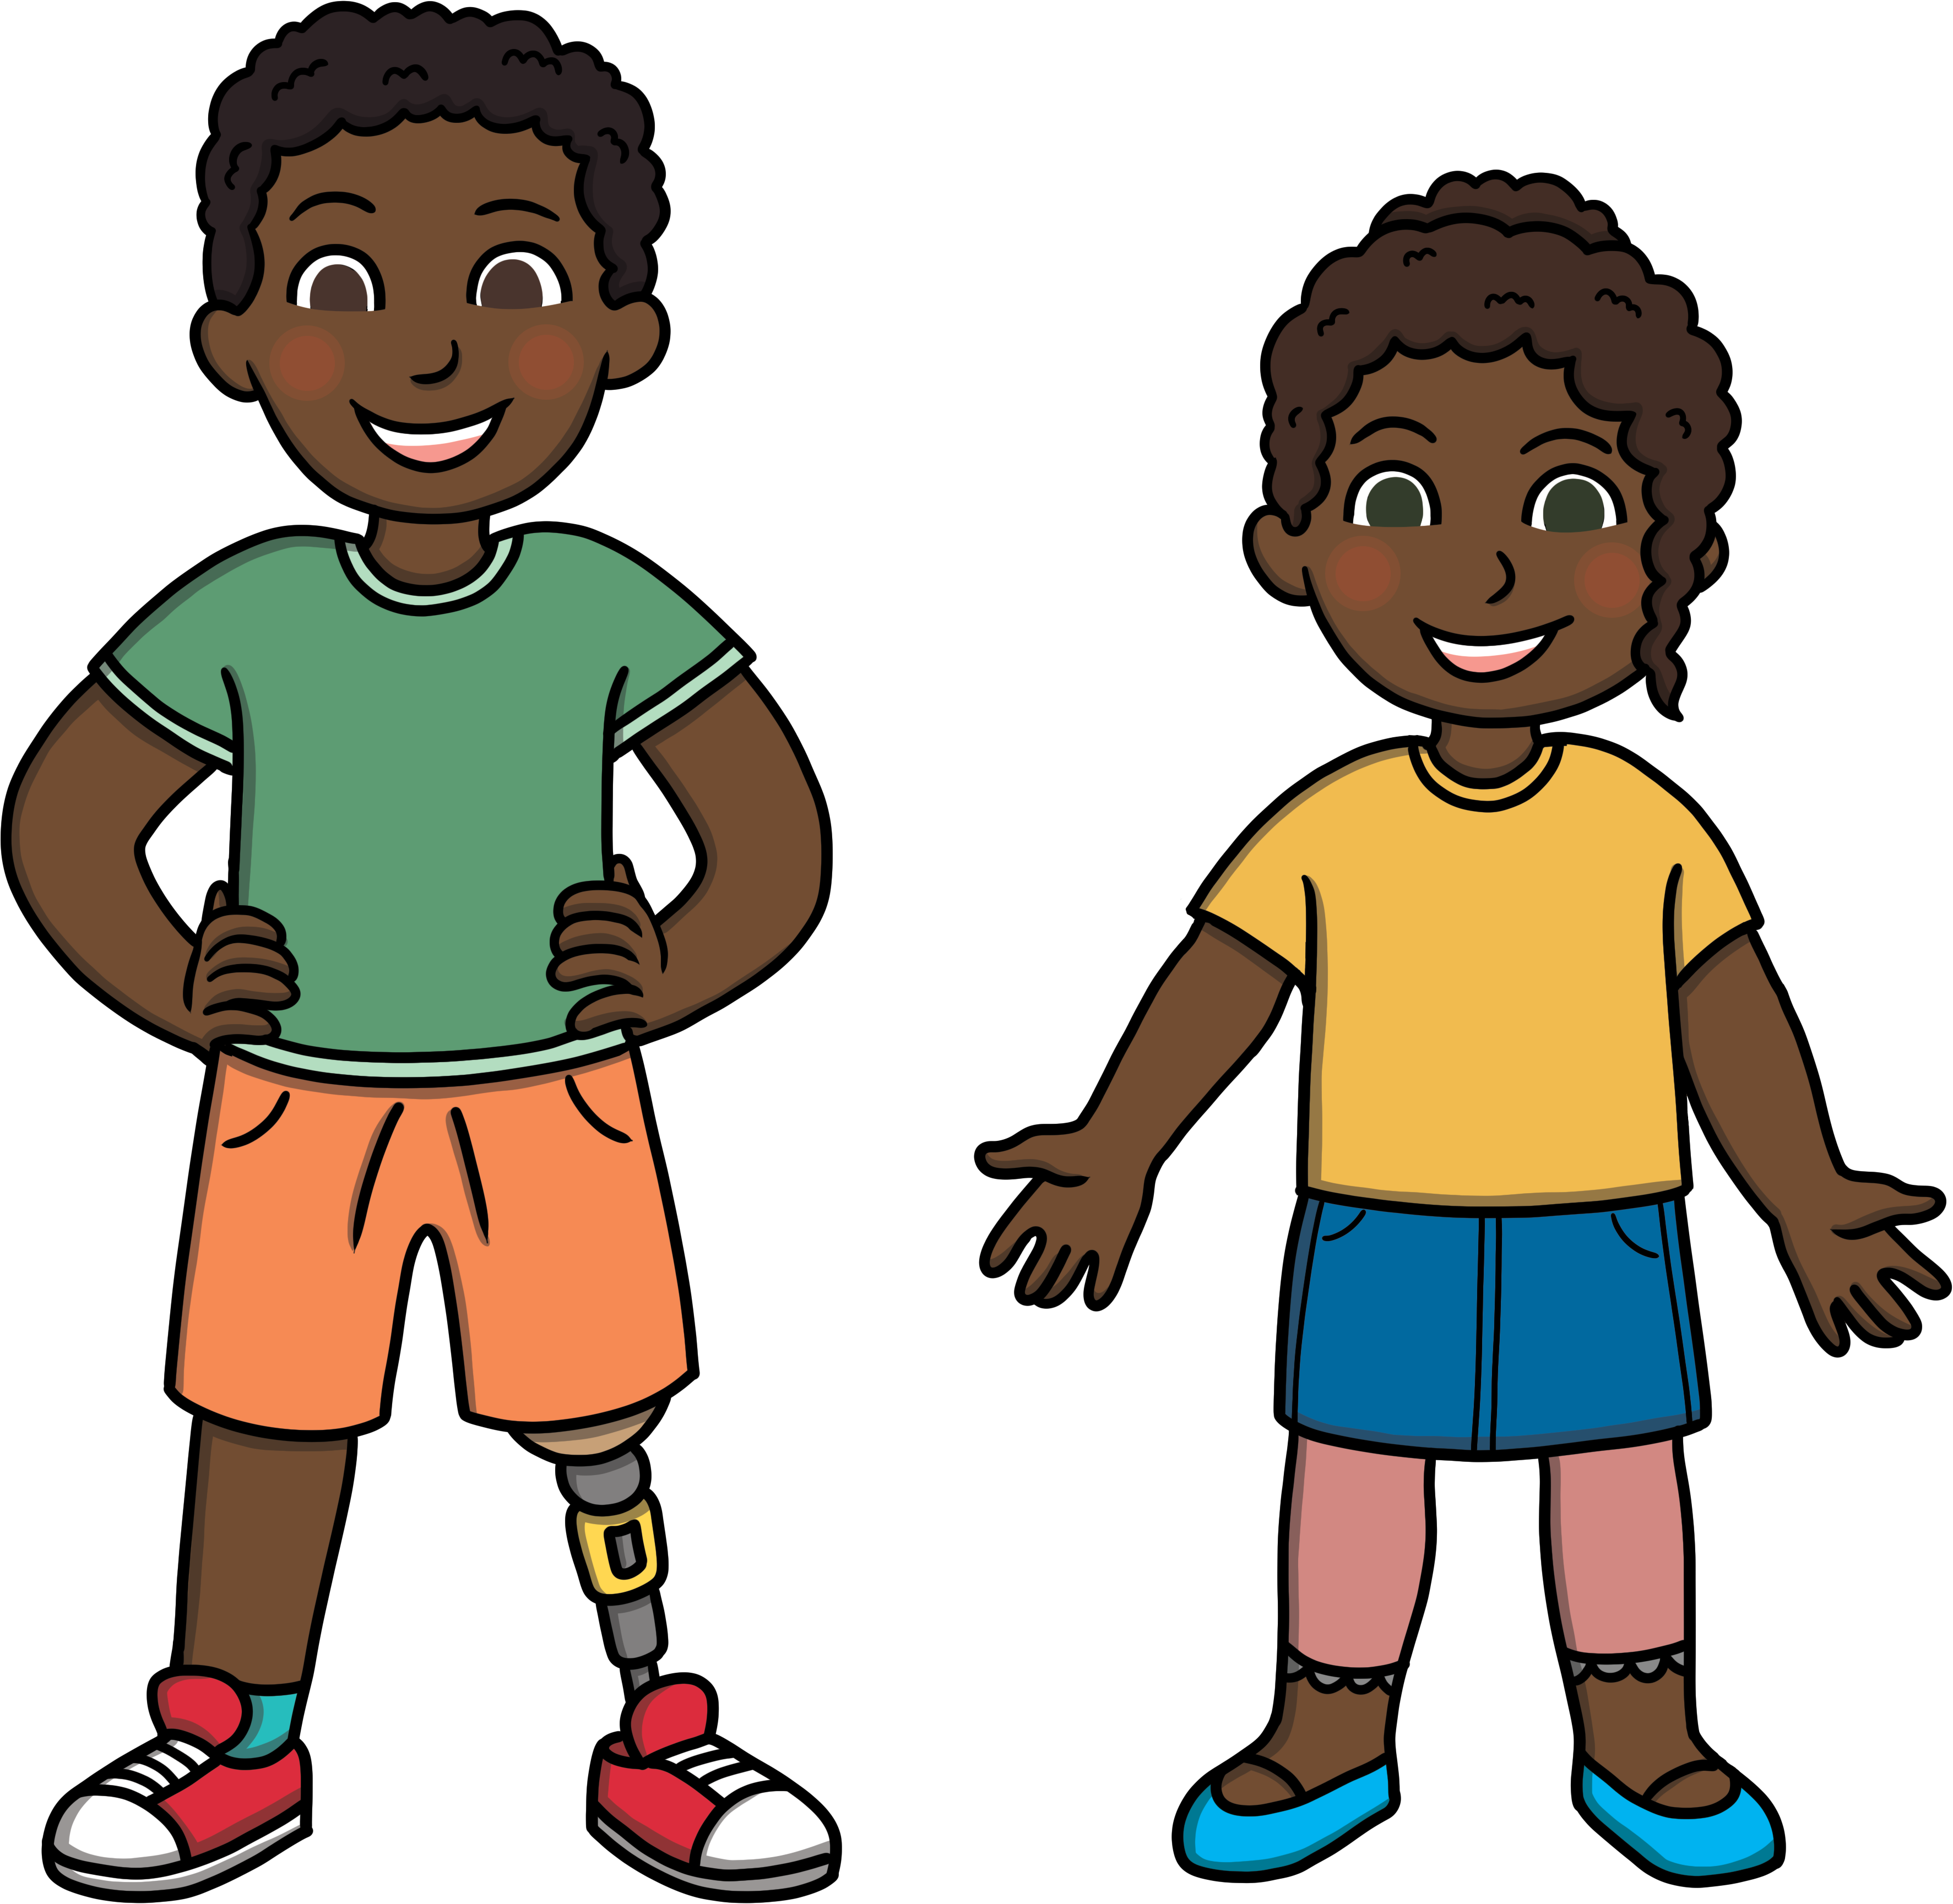
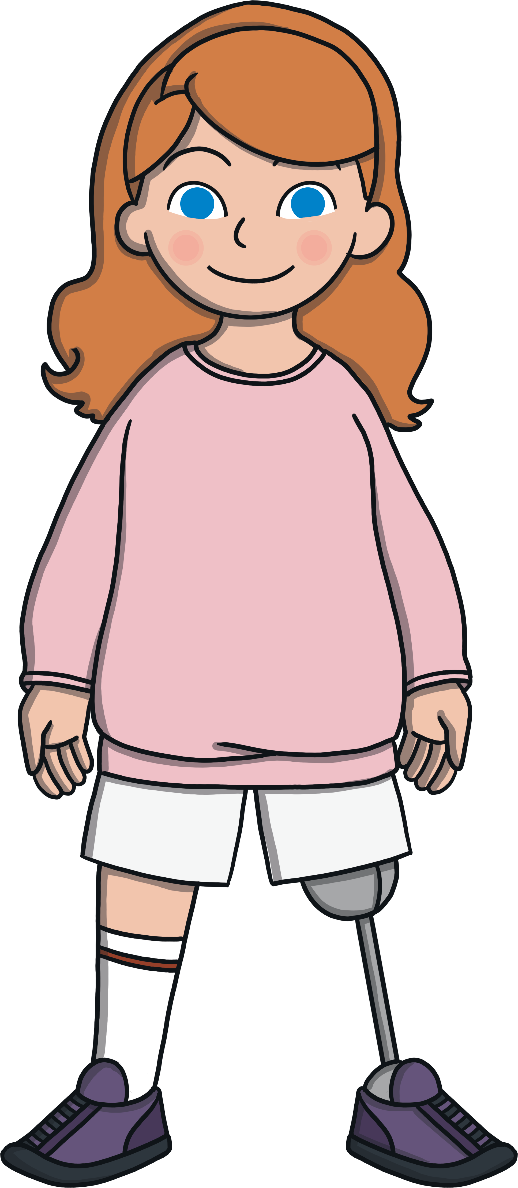
Question
4
Why do we wear poppies on Remembrance Day?

Slide 9
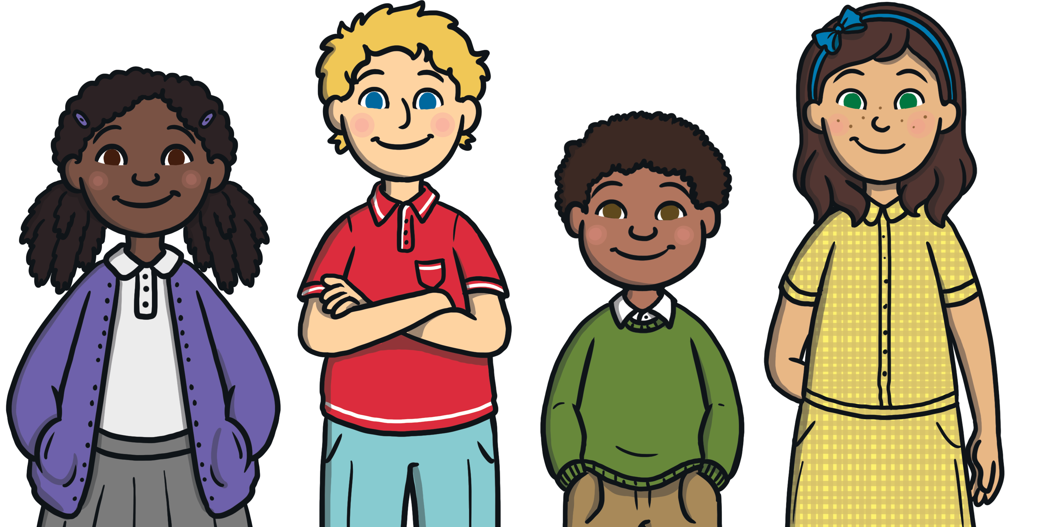
Answer
4
Poppies are worn on Remembrance Day because they are the flowers that grew on the battlefields after World War I ended. The Royal Canadian Legion sells poppies every Remembrance Day to raise money to support war veterans in Canada.

Slide 10
Question
5
What is the word we use to describe someone who has fought in a war?

Slide 11
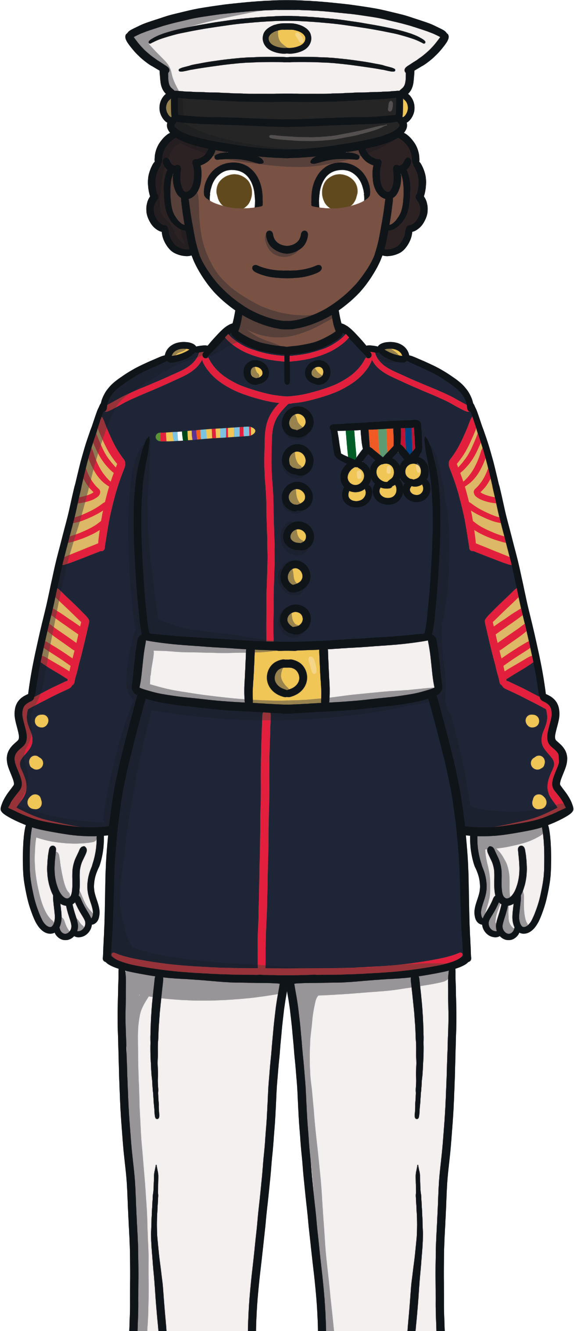
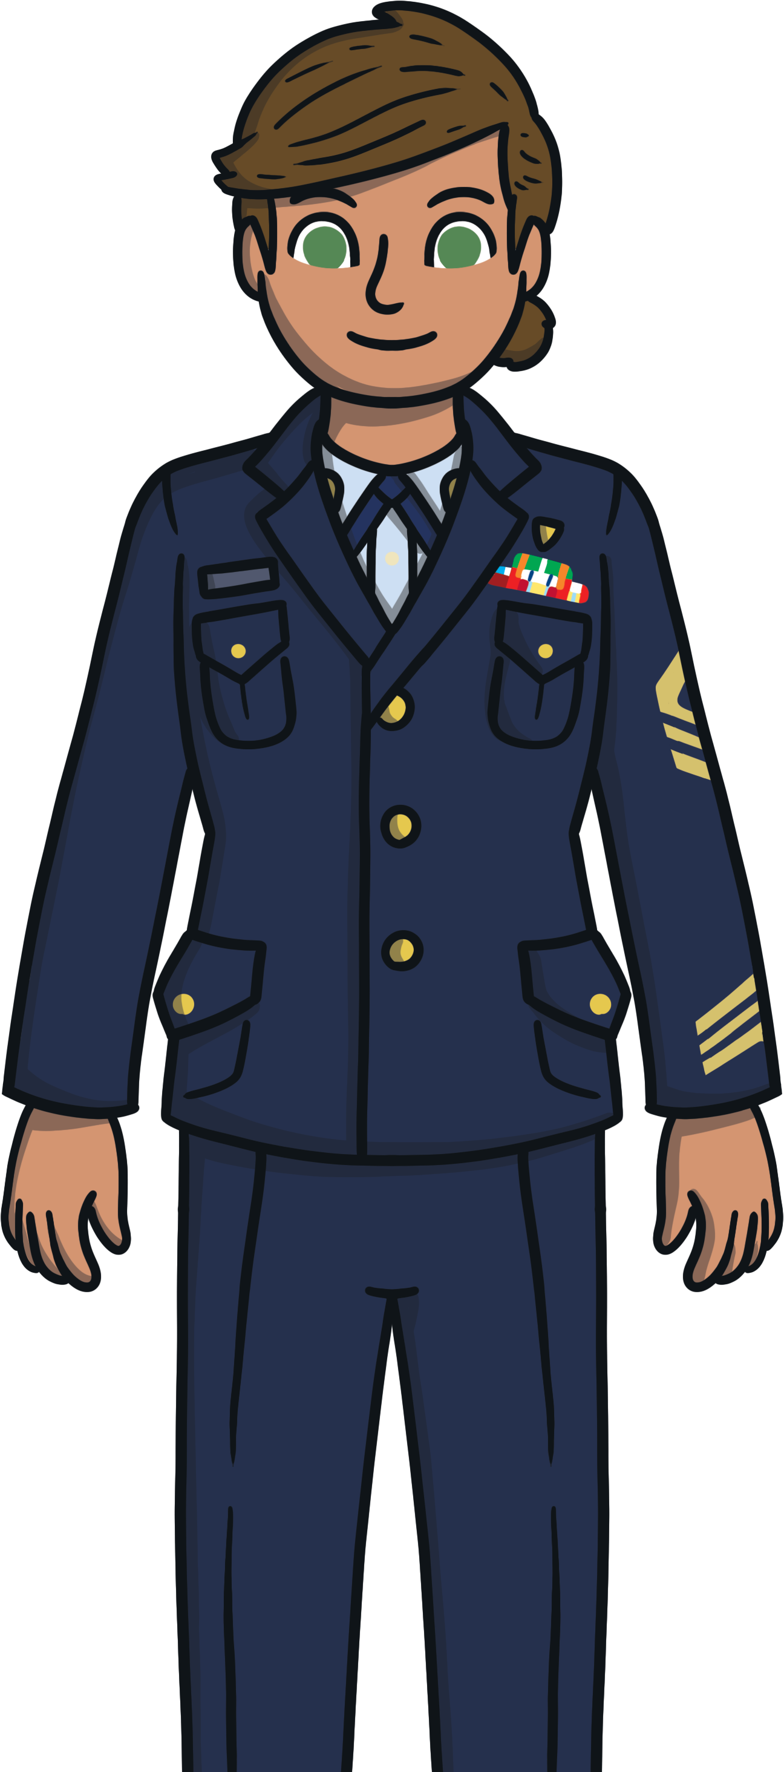
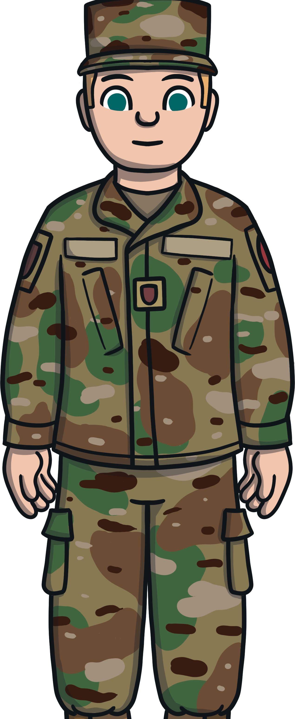
Answer
5
A person who has fought in a war is called a veteran.

Slide 12
Question
6
Why is Remembrance Day so important?

Slide 13
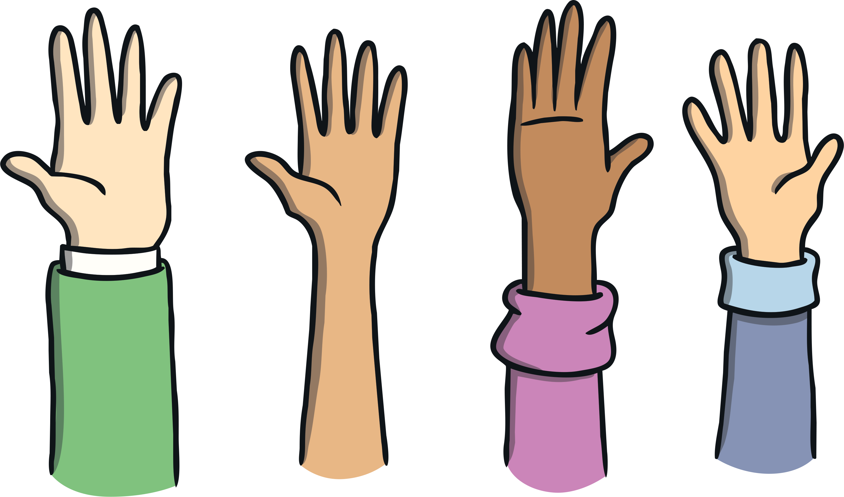
Answer
6
Let’s have a class discussion!

