Slide 2
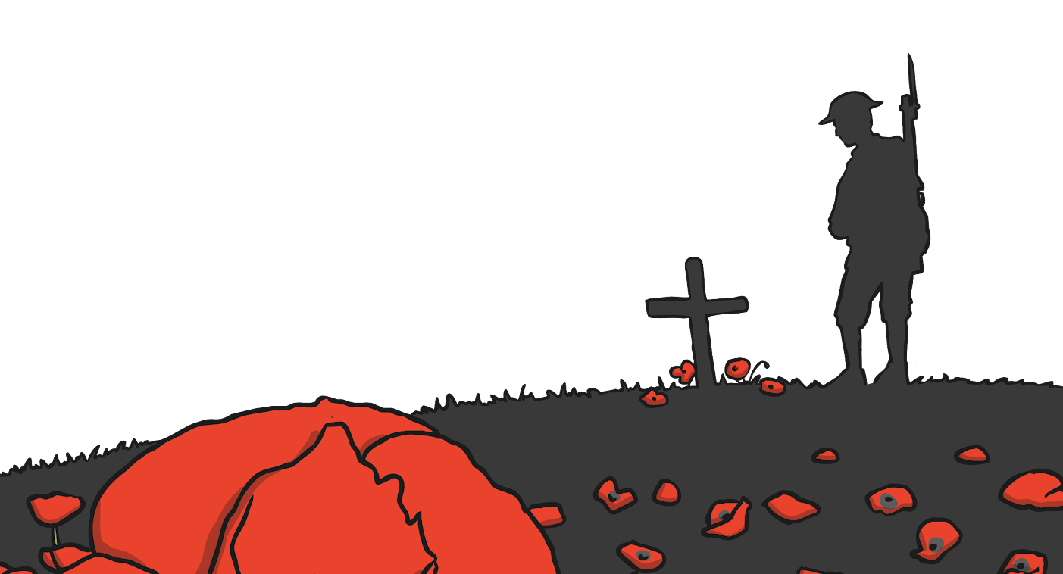
What is Remembrance Day?
Remembrance Day is held on November 11th each year. It is a time when Canadians and others from around the world remember the service, courage and sacrifice that our soldiers gave for their country, so that we may live in freedom.
We remember our fallen soldiers of the past and present as
Well as our soldiers who survived and still serve our country
today in war, conflict and peace.

Slide 3
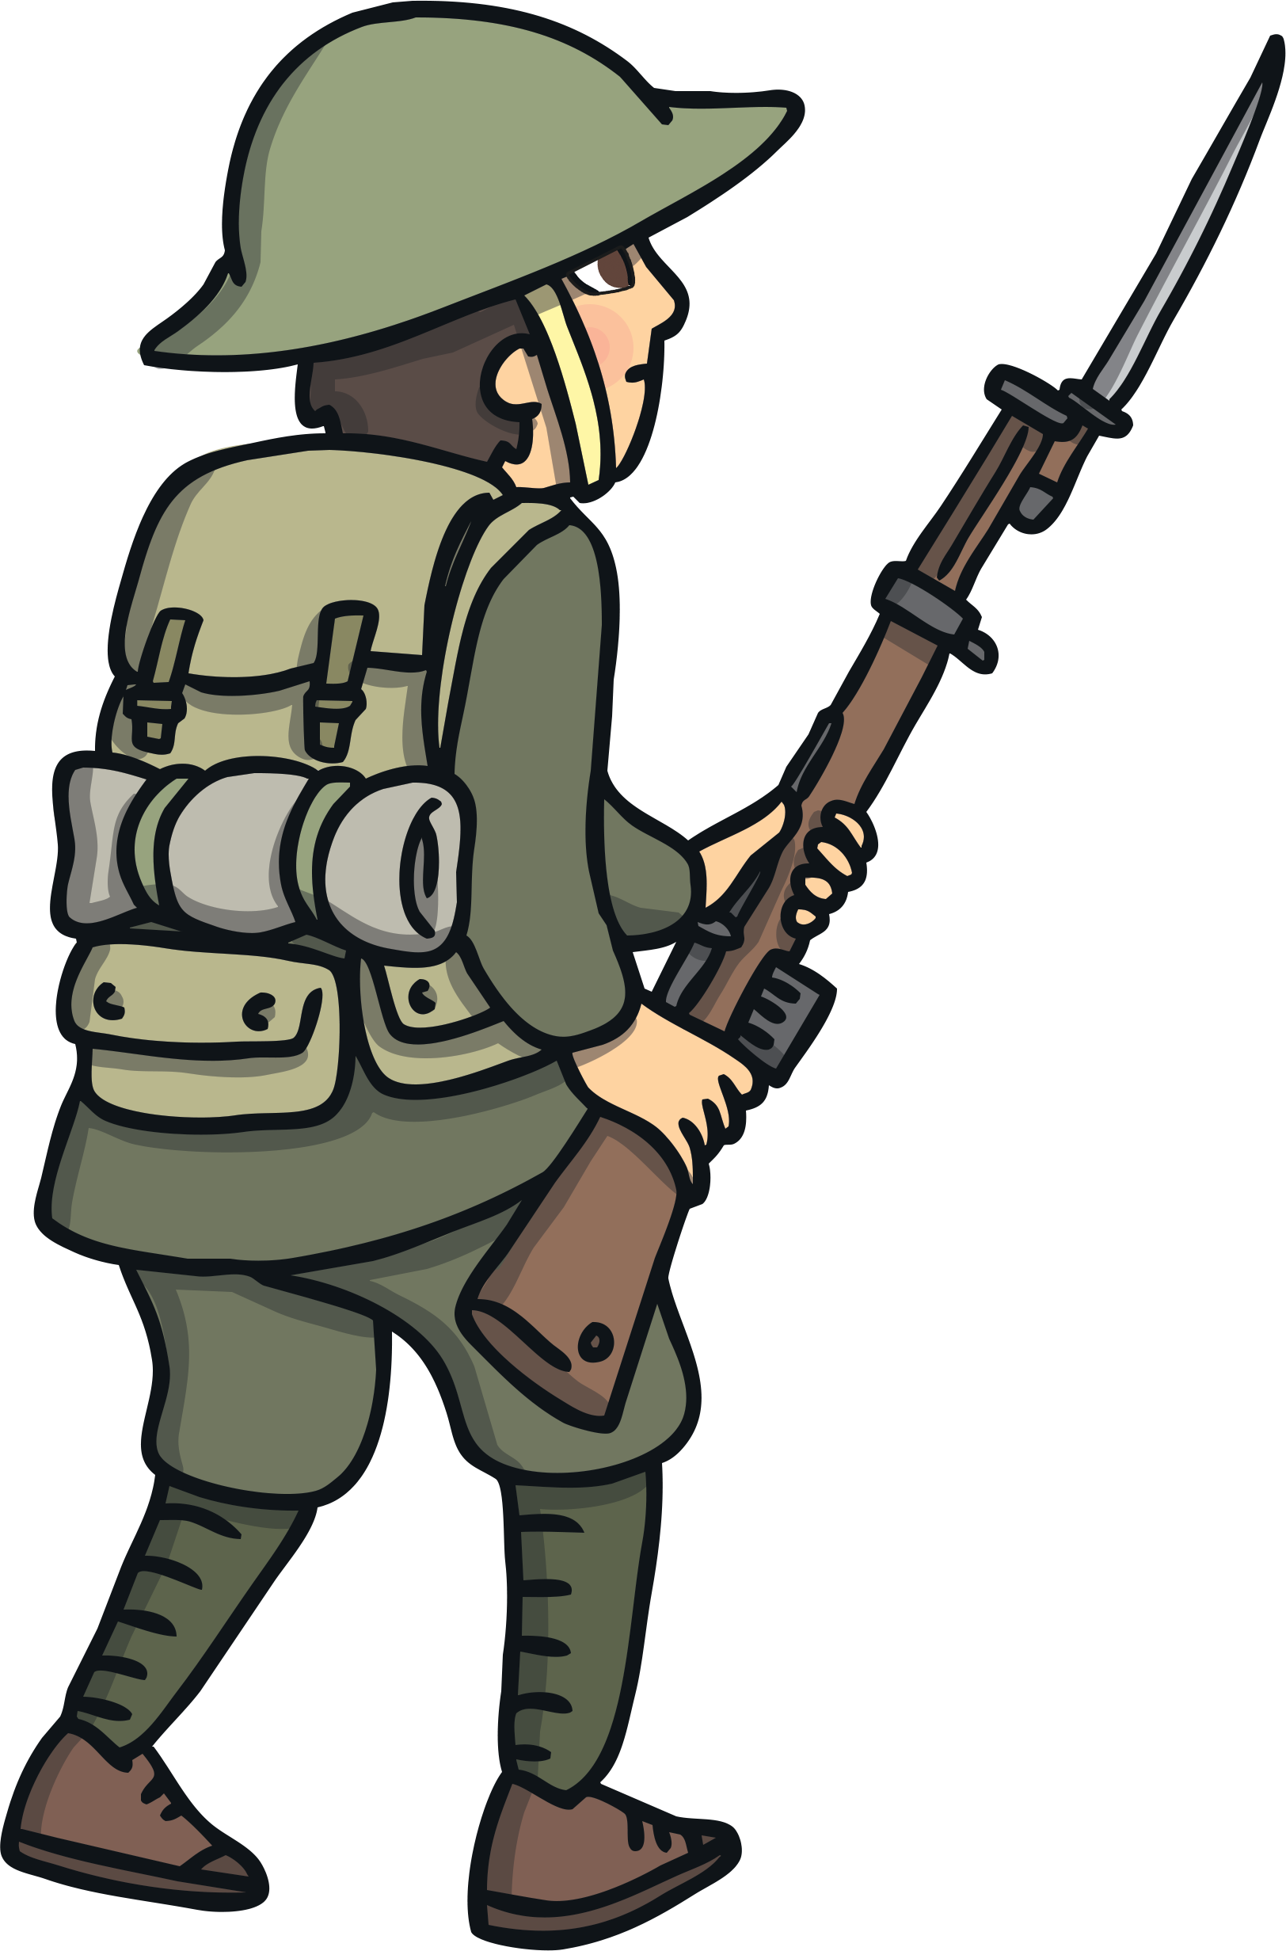
We Remember
On November 11th, at 11 a.m., we take a moment to remember our soldiers.
We remember our soldiers at 11 a.m., because this is the moment the fighting ended during the First World War.

Slide 4
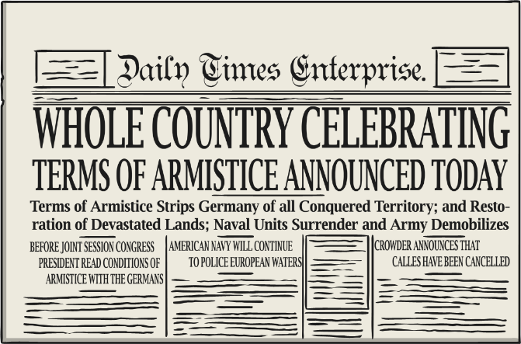
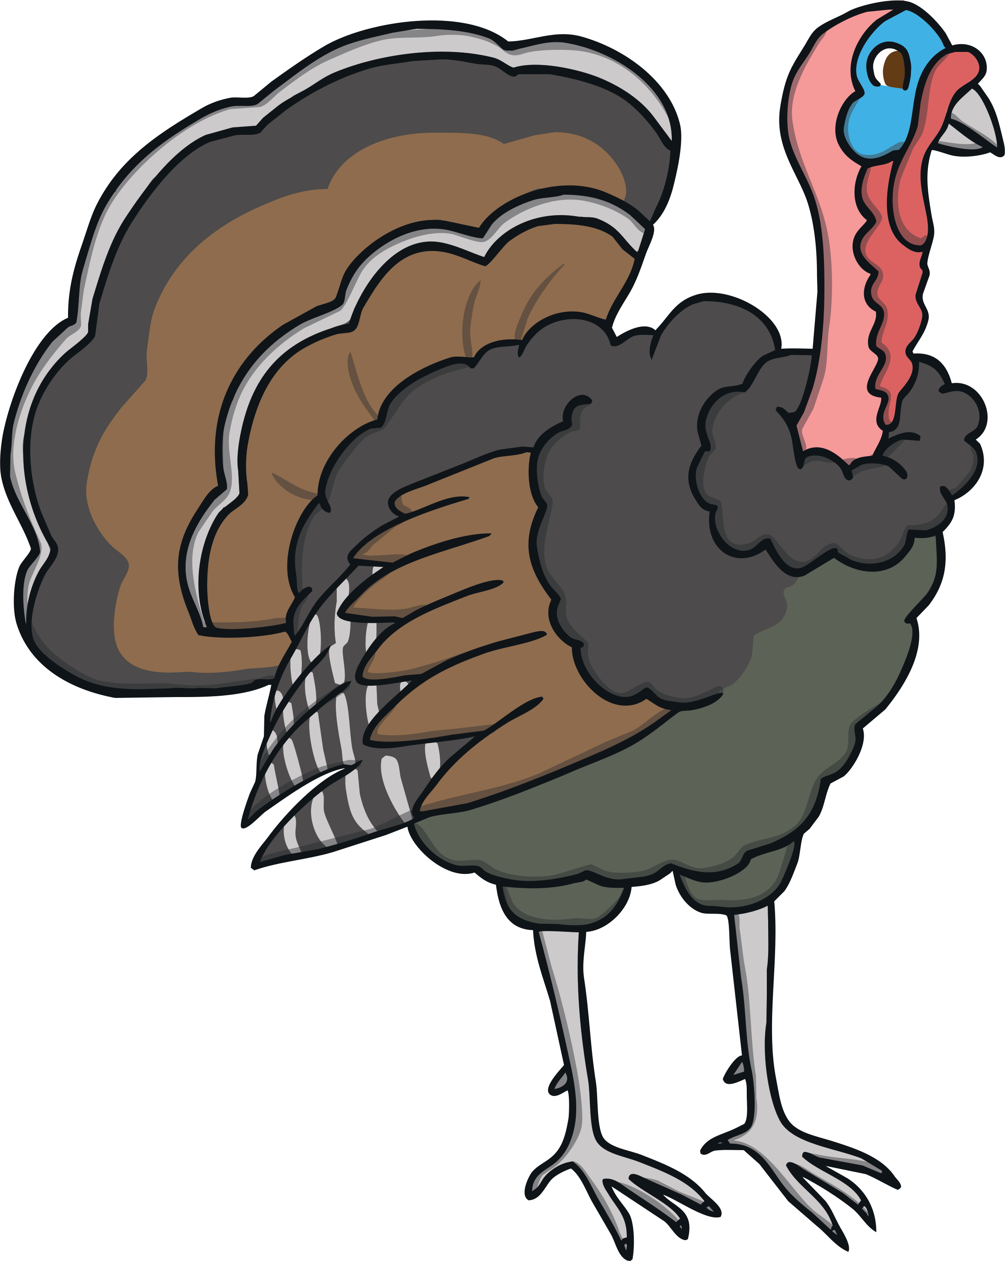
Start of Remembrance Day
Remembrance Day was originally called Armistice Day and was observed at the same time as Thanksgiving.
This changed in 1931. The federal government of Canada decided that Remembrance Day would continue to be observed on November 11th and Thanksgiving would be moved to another date.

Slide 5
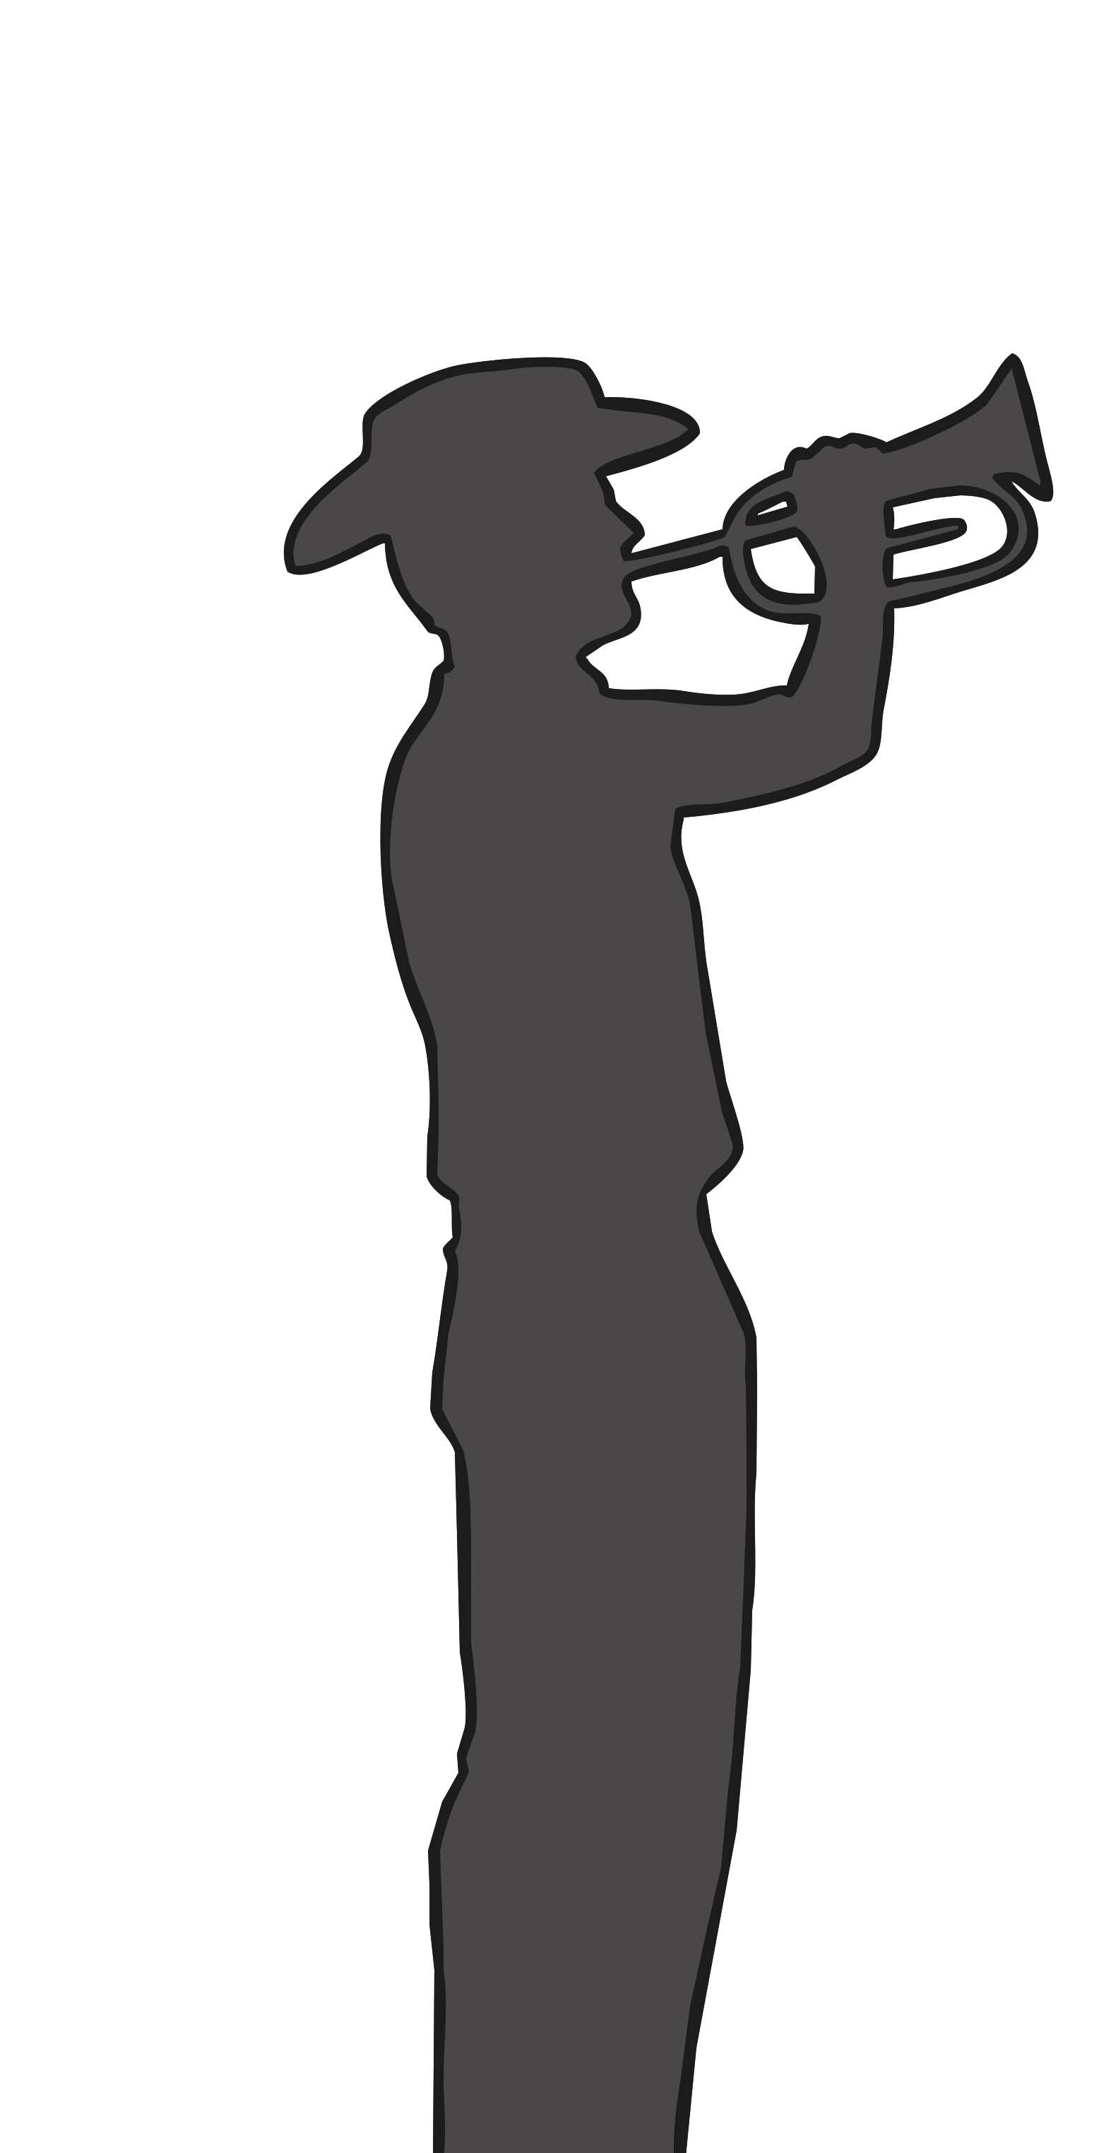
Songs Played on Remembrance Day
Reveille
The first bugle call of the day to wake soldiers in the morning.
During Remembrance Day ceremonies, it is played to signify the resurrection of the spirit of the fallen.
The Last Post
Traditionally, the “Last Post” was played when the final inspection of the day was complete. This let people know that the camp was safe for the night. It is also a bugle call.
In a Remembrance Day service, it symbolizes death.

Slide 6
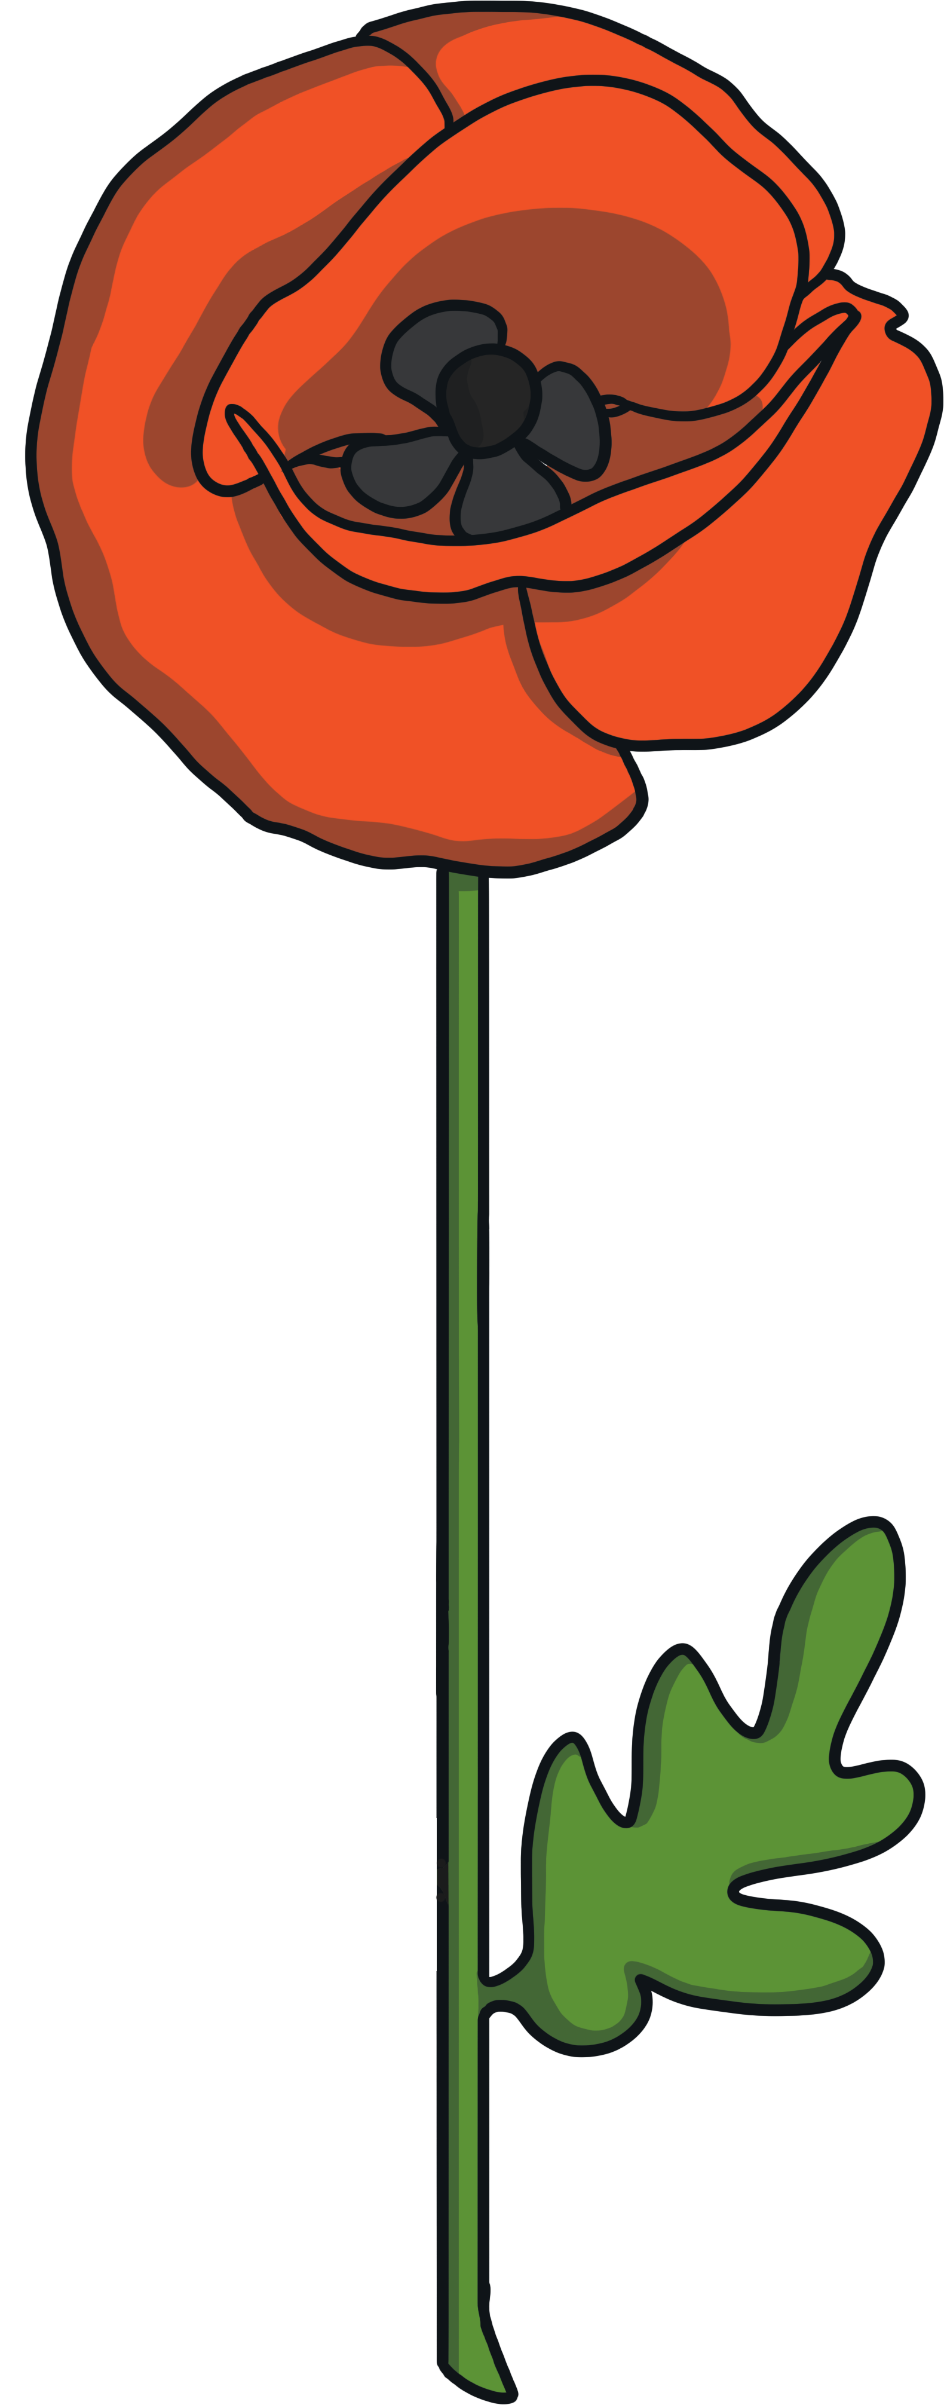
Why We Wear Poppies
The poem, “In Flanders Fields” by Canadian poet, soldier and physician John McCrae made wearing poppies around Remembrance Day popular.
It is a symbol of remembrance and the blood shed by many soldiers for us and our freedom.

Slide 7
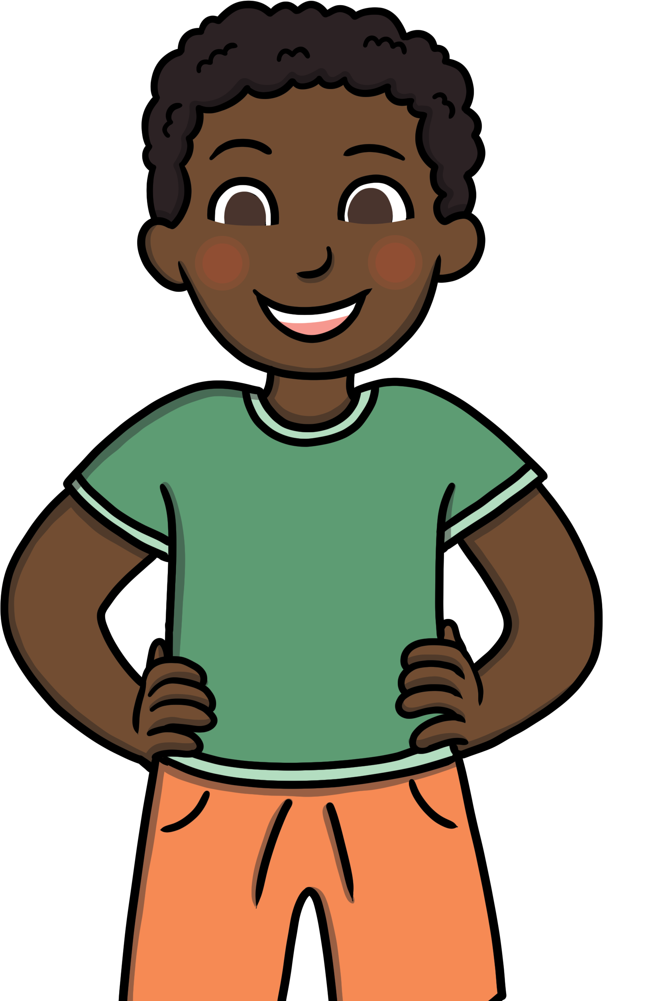
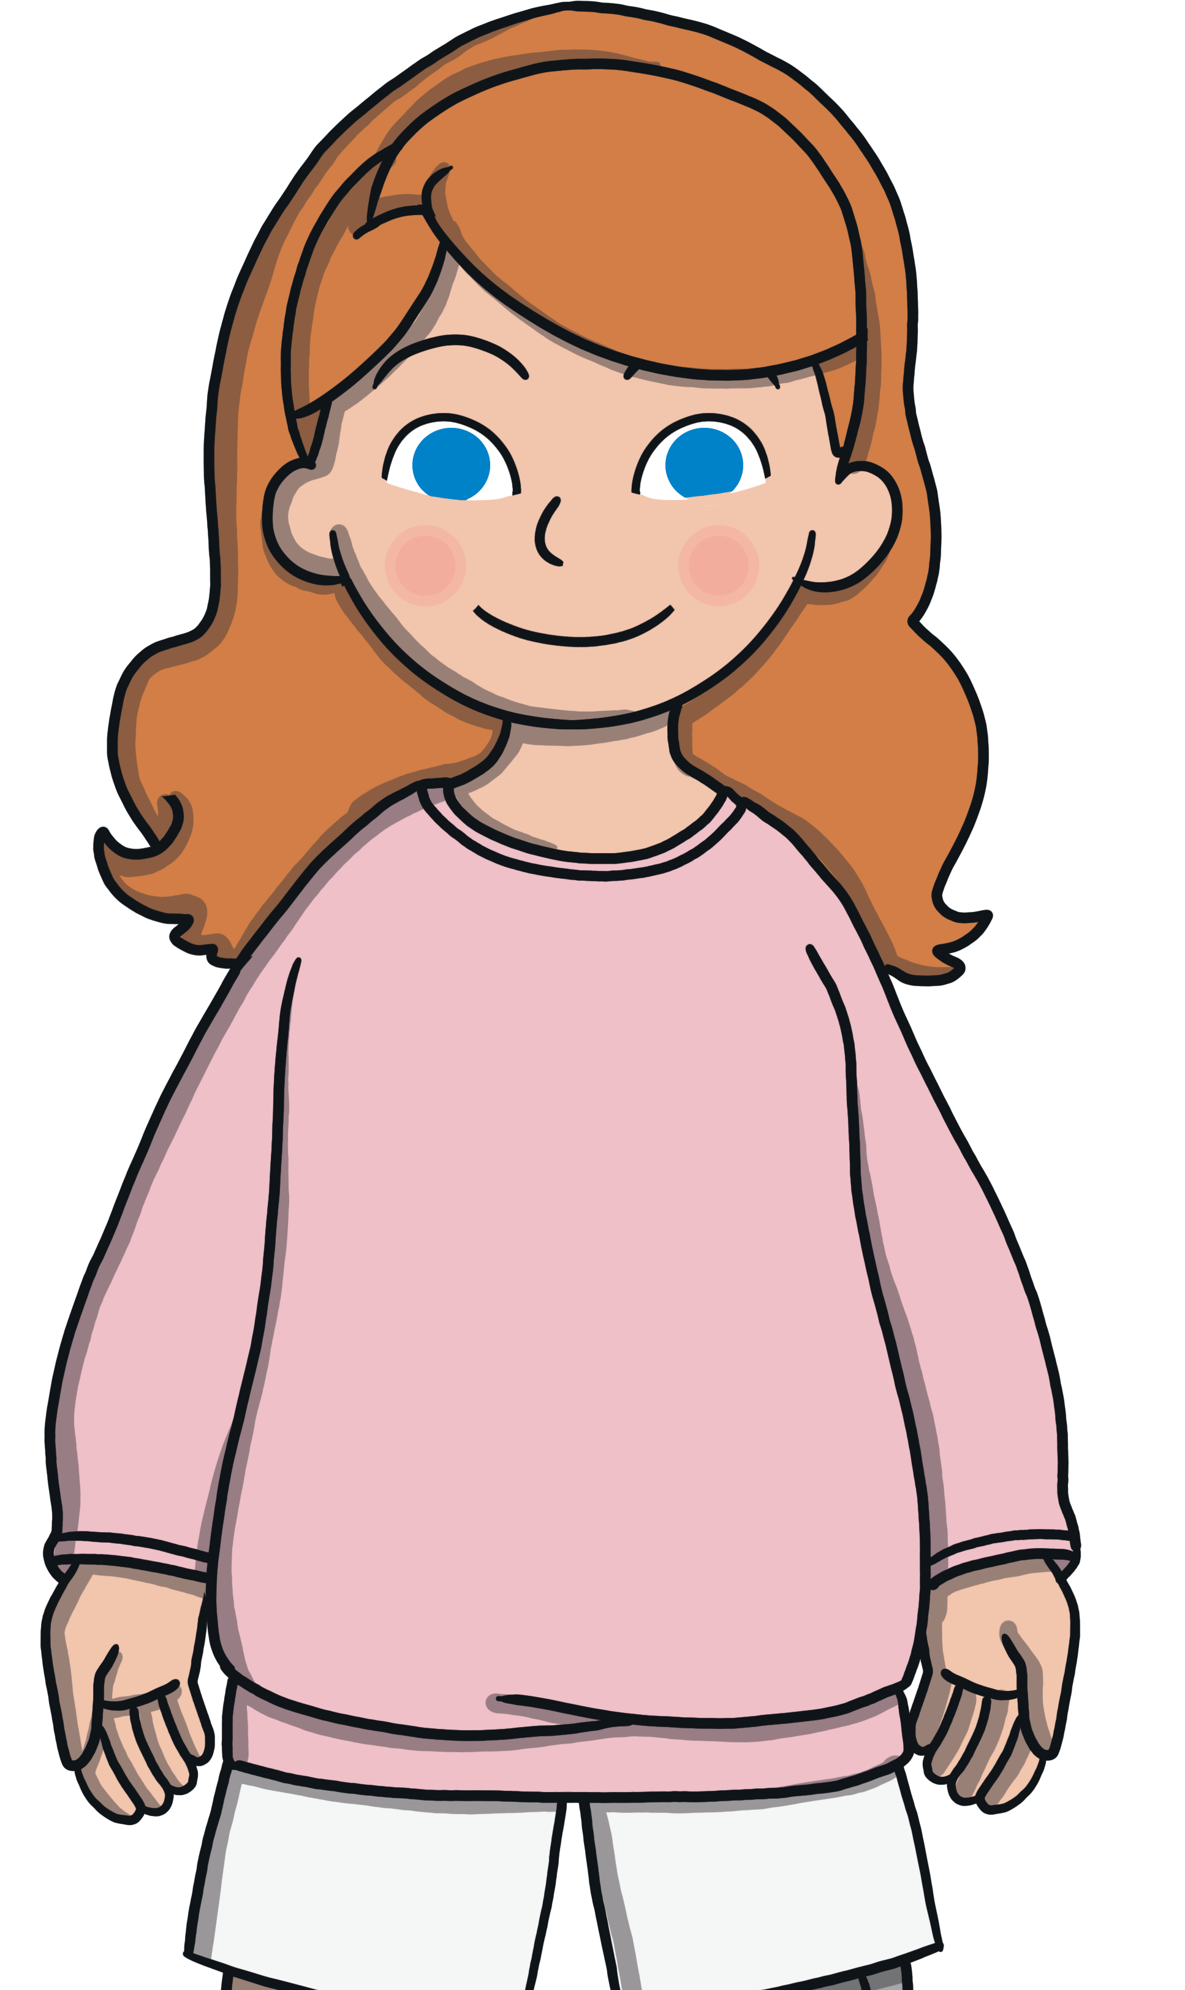
The Poppy Campaign
Did you ever wonder where the money from the purchase of poppies to wear goes to?
The Poppy Campaign is held across Canada from the last Friday of October to November 11th.
The Poppy Campaign uses the donations from the poppies to support our veterans and current soldiers buy necessities such as wheelchair ramps, food, eyeglasses, etc.

Slide 8
Where is Remembrance Day Observed in Canada?
Remembrance Day is observed throughout Canada and the Commonwealth.
The official national ceremony is at the National War Memorial in Ottawa. The Prime Minister, Governor General and Silver Cross Mother are there. Sometimes, a member of the Royal Family is in attendance.

Slide 9
The Silver Cross Mother
The Royal Canadian Legion chooses a woman to represent all mothers who have lost a child who served in war. This woman lays a wreath during the National Remembrance Day ceremony at the National War Memorial in Ottawa. A different woman is chosen each year from all over Canada.
The Silver Cross is a medal that is awarded to mothers who have lost a child in war. It is awarded by the Canadian Forces on behalf of the Queen.

Slide 10
Veterans’ Week
Veterans’ Week is held across Canada the week of Remembrance Day.
During this week there are many opportunities to remember our soldiers with events throughout the country.

Slide 11
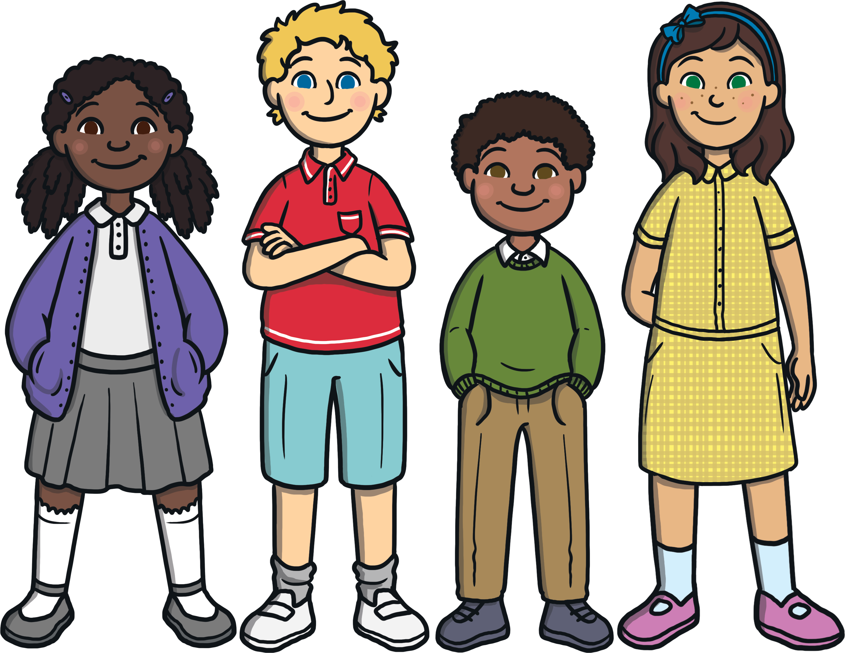
Reflection Questions
Why is Remembrance Day important?
What can we do to bring peace to our world?

Slide 12
Remember Them

